Slide 1


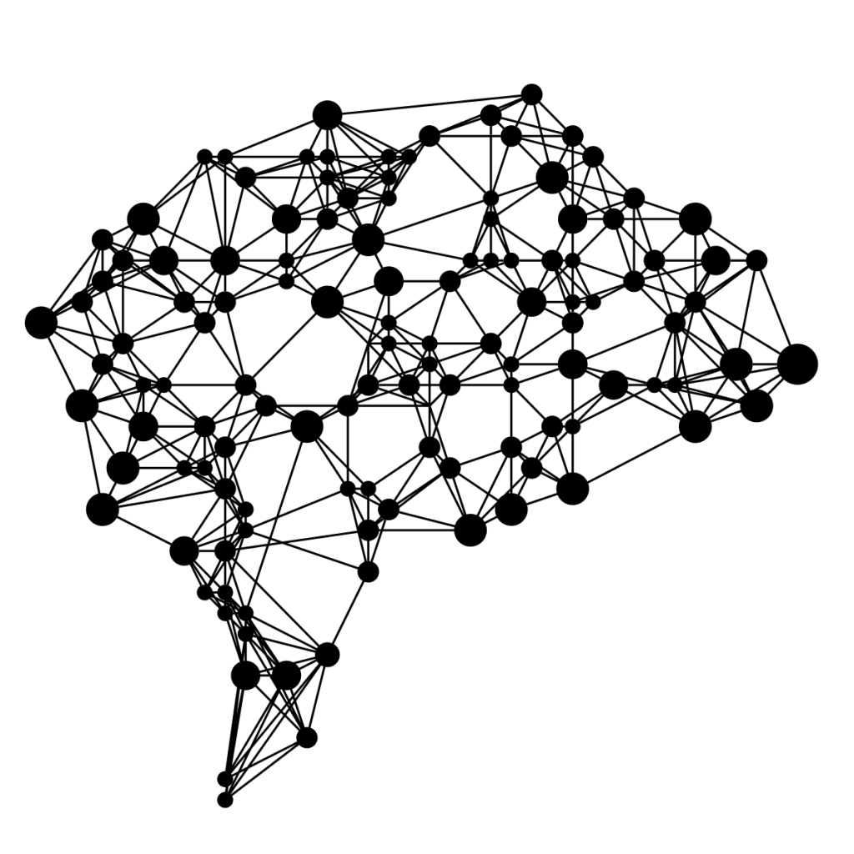
Identification of patients with atrial fibrillation during normal sinus rhythm using different methodologies and machine learning techniques
Academic year 2022 - 2023
Alexandre CHAPELLE – 000524758
Promotor : Prof. Hugues BERSINI Supervisor : Cédric GILON

Slide 2

Presentation outline
Objectives
The heart and arrhythmias
Artificial intelligence
Methodologies
Results
Conclusion
Alexandre Chapelle
000524758
Identification of patients with atrial fibrillation during normal sinus rhythm using different methodologies and machine learning techniques
Presentation outline

Slide 3
Objectives

Slide 4
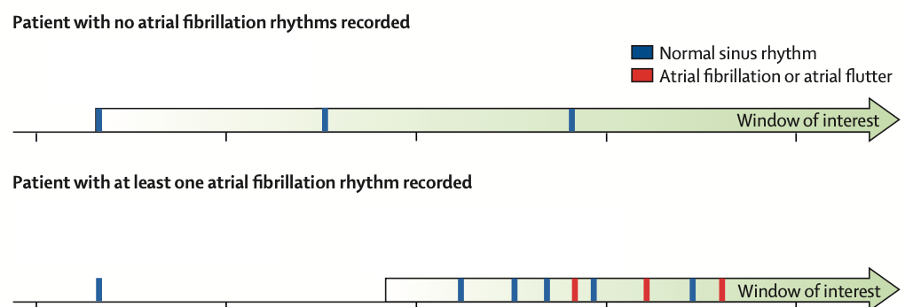
Objectives
Atrial fibrillation:
Most common arrhythmia
Affects 32 millions people worldwide
Can lead to severe cardiac complications
Stroke
Heart failure
Identification during opportunistic screening
ECG selection and windows of interest for patients with multiple ECGs Attia et al. 2019
Alexandre Chapelle
000524758
Identification of patients with atrial fibrillation during normal sinus rhythm using different methodologies and machine learning techniques
Objectives

Slide 5
The heart and arrhythmias

Slide 6
The heart and arrhythmias
Heart:
Muscular organ
4 parts separated by 2 septa
Right and left atria
Right and left ventricles
4 valves
Ensure blood circulation
Rhythmic contractions
Between 60 to 70 bpm at rest
Warrier, L. (2017). Structure and beating of the human heart.
Alexandre Chapelle
000524758
Identification of patients with atrial fibrillation during normal sinus rhythm using different methodologies and machine learning techniques
The heart and arrhythmias

Slide 7
The heart and arrhythmias
Electric signal:
Generated by sinoatrial node
Recorded by electrocardiographs
Electrocardiograms
P-wave
Activation of atria
QRS complex
Activation of ventricles
T-wave
Electric recovery of ventricles
ECG Animation - Electrical Changes in Heart
Alexandre Chapelle
000524758
Identification of patients with atrial fibrillation during normal sinus rhythm using different methodologies and machine learning techniques
The heart and arrhythmias

Slide 8
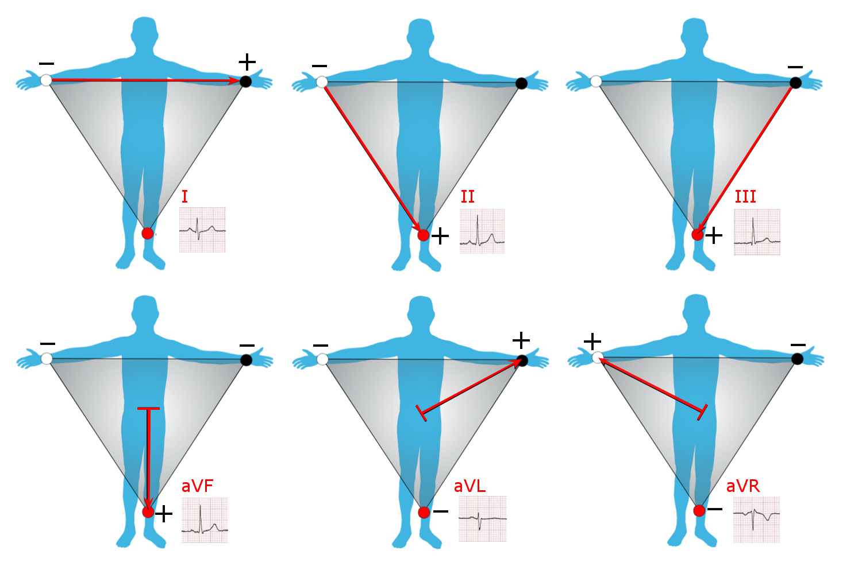
The heart and arrhythmias
Leads:
Different views
12-leads ECG
10 pads
RA, LA, RL, LL
V1 to V6
Placed between the ribs
Example: Lead II
HMN Wiki. Électrocardiographie.
Alexandre Chapelle
000524758
Identification of patients with atrial fibrillation during normal sinus rhythm using different methodologies and machine learning techniques
The heart and arrhythmias

Slide 9
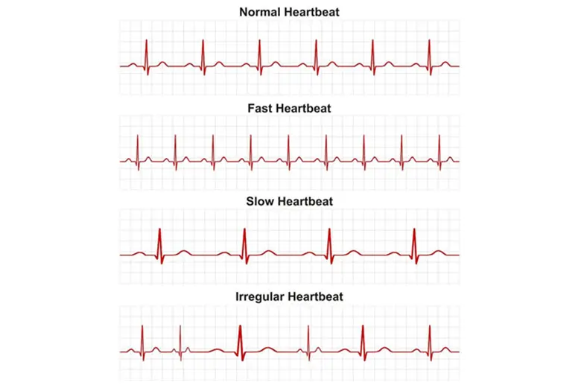

The heart and arrhythmias
Arrythmias:
Tachycardia
Fast heartbeat
Bradycardia
Slow heartbeat
Atrial fibrillation
Irregular heartbeat
Alexandre Chapelle
000524758
Identification of patients with atrial fibrillation during normal sinus rhythm using different methodologies and machine learning techniques
The heart and arrhythmias

Slide 10
Artificial intelligence

Slide 11
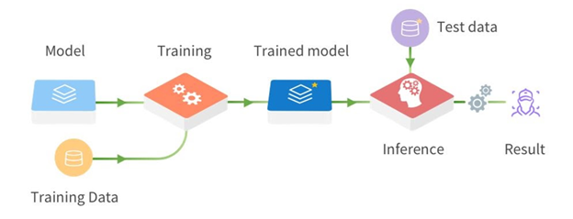
Artificial intelligence
”Sets of techniques and methods used to reproduce natural intelligence”
Copy cognitive functions to learn and solve problems
Machine learning
Branch of artificial intelligence
Use algorithms to make predictions or classifications
Improve their performances over time
Supervised learning
Deep learning
Alexandre Chapelle
000524758
Identification of patients with atrial fibrillation during normal sinus rhythm using different methodologies and machine learning techniques
Artificial intelligence

Slide 12
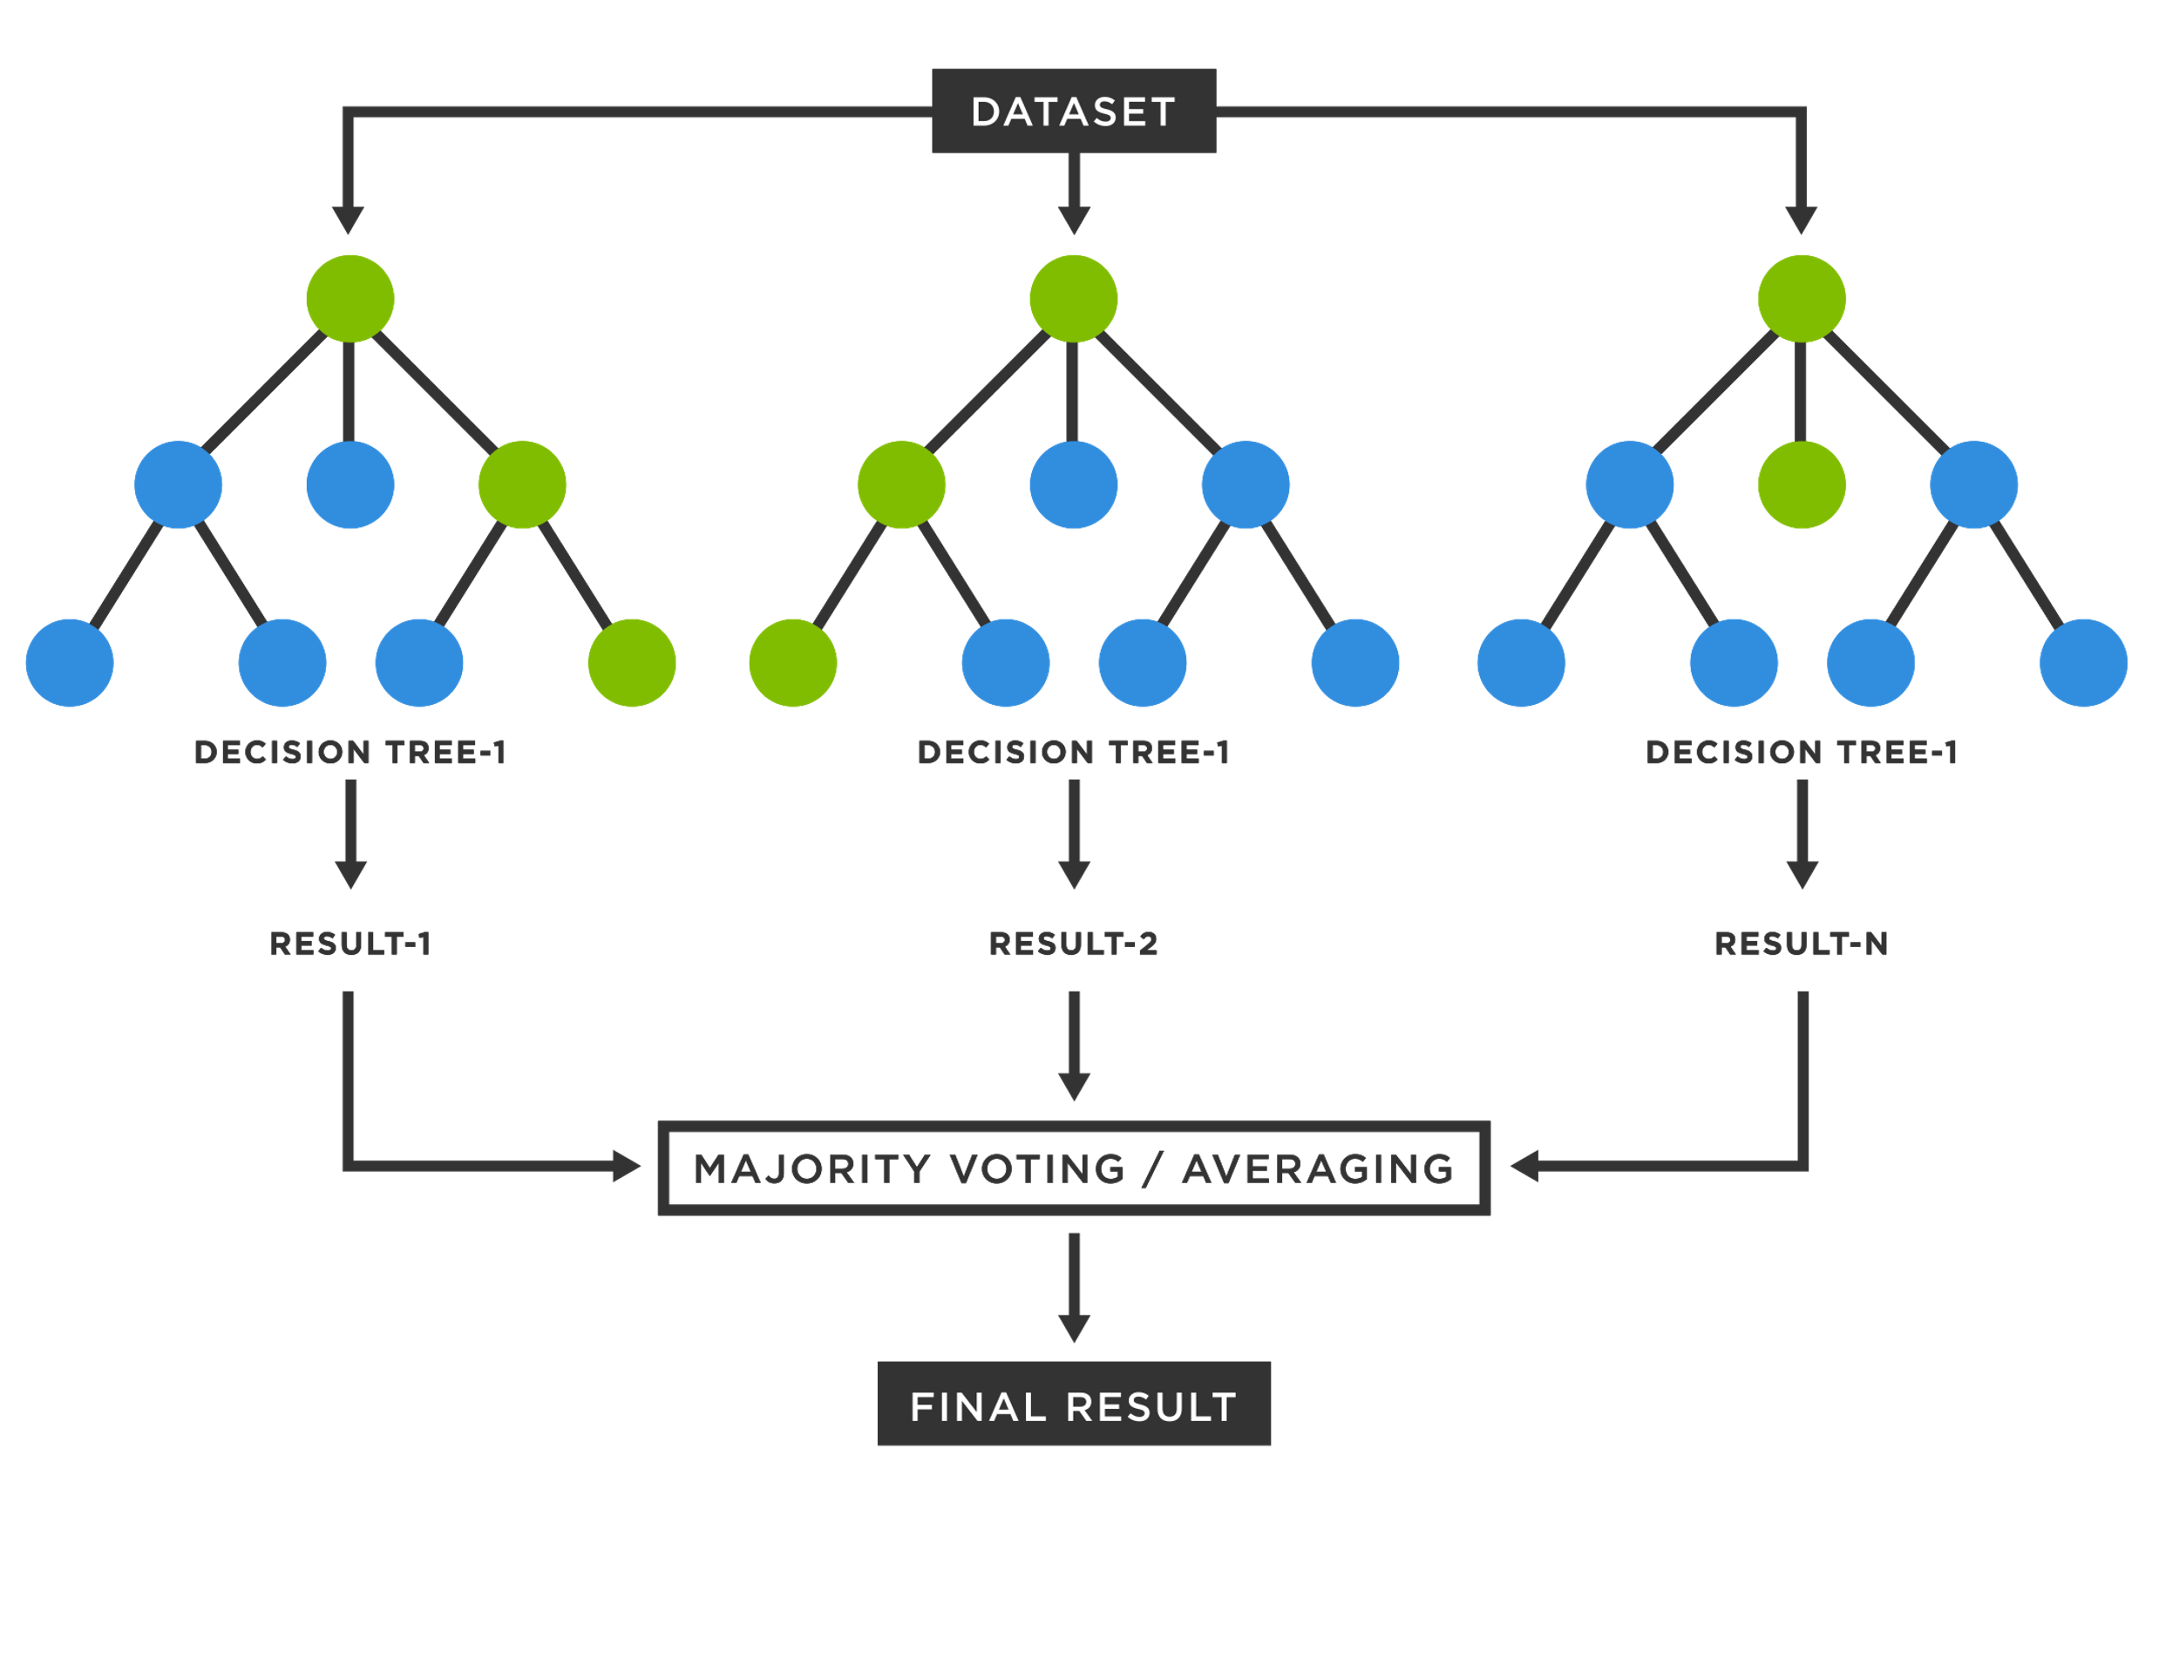
Artificial intelligence
Random Forest:
Collection of decision trees
Alexandre Chapelle
000524758
Identification of patients with atrial fibrillation during normal sinus rhythm using different methodologies and machine learning techniques
Artificial intelligence

Slide 13
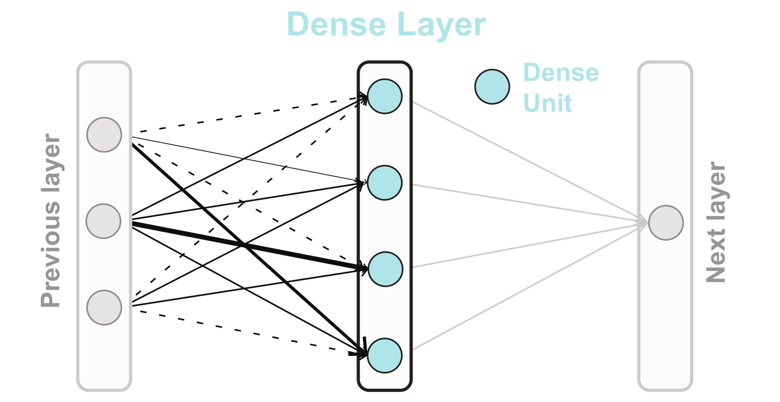
Artificial intelligence
Convolutional Neural Network:
Components:
Convolutional layer
Detects local patterns
Pooling layer
Reduces dimensions
Dense layer
Output results
Alexandre Chapelle
000524758
Identification of patients with atrial fibrillation during normal sinus rhythm using different methodologies and machine learning techniques
Artificial intelligence

Slide 14
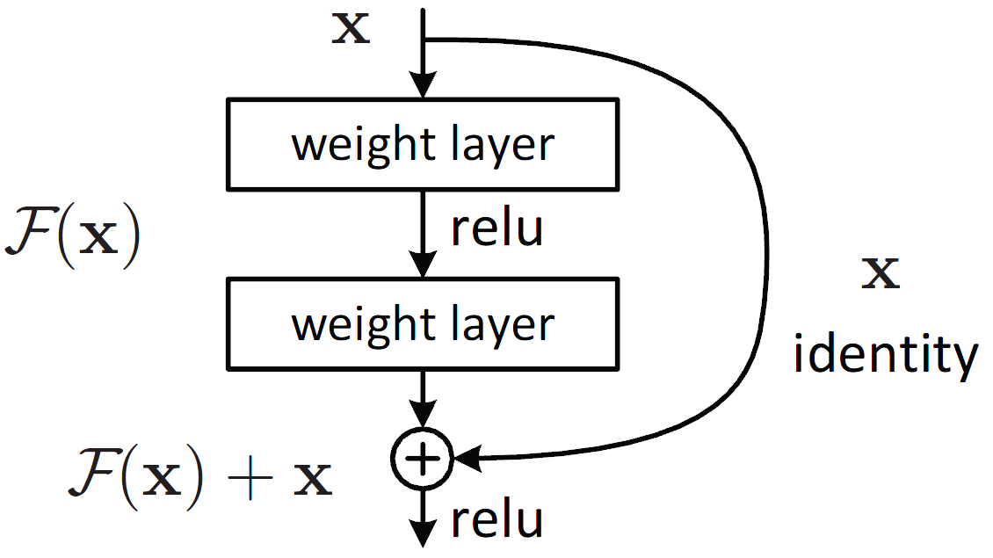
Artificial intelligence
ResNet:
Residual networks
Prevent vanishing gradients issue
Shortcut (skip) connection
Alexandre Chapelle
000524758
Identification of patients with atrial fibrillation during normal sinus rhythm using different methodologies and machine learning techniques
Artificial intelligence

Slide 15
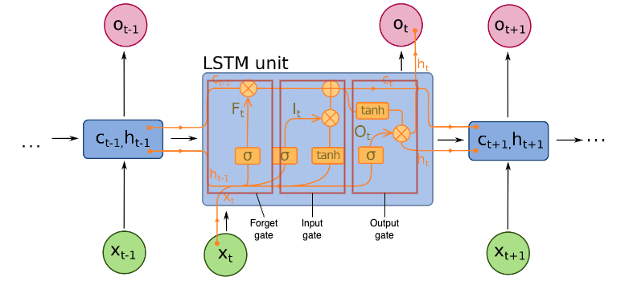
Artificial intelligence
LSTM:
Long-Short Term Memory
Type of RNN
Capture long-term dependencies
Relationship or associations between elements
3 gates:
Forget gate
Input gate
Output gate
Cell state
Kind of conveyor belt
Alexandre Chapelle
000524758
Identification of patients with atrial fibrillation during normal sinus rhythm using different methodologies and machine learning techniques
Artificial intelligence

Slide 16
Methodologies

Slide 17
Methodologies
3 different databases
4 methodologies derived from scientific literature
10-second segments
Defined number of beats per segment (Beats)
RR intervals (RRI)
Peaks metrics (Peaks)
3 pre-processing techniques
Manual pre-processing
Automatic pre-processing
Raw data
4 machine learning models
Alexandre Chapelle
000524758
Identification of patients with atrial fibrillation during normal sinus rhythm using different methodologies and machine learning techniques
Methodologies

Slide 18
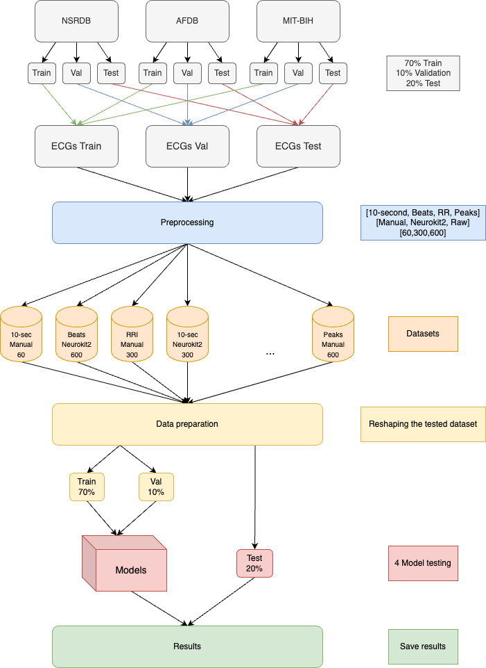
Methodologies
Complete overview
7:1:2 ratio
70% train
10% validation
20% test
24 datasets
Methodology + pre-processing + duration
Alexandre Chapelle
000524758
Identification of patients with atrial fibrillation during normal sinus rhythm using different methodologies and machine learning techniques
Methodologies

Slide 19
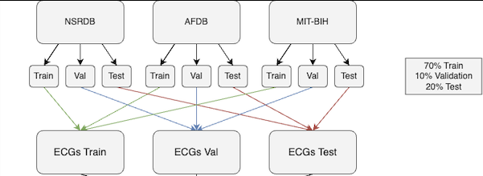
Methodologies
Databases:
NSRDB (Normal Sinus Rhythm Database)
AFDB (Atrial Fibrillation Database)
MIT-BIH (MIT-BIH Arrythmias)
ECG files annotated by
specialists
90 subjects
18 healthy
72 unhealthy
Lead II channel
 | NSRDB | AFDB | MIT-BIH
Subjects | 18 | 25 | 47
Duration (hour) | 24 | 10 | 0.5
Sampling frequency | 128 Hz | 250 Hz | 360 Hz
Annotations | Beat | Beat and rhythm | Beat
Channels | Lead II & aVL | Lead II & aVL | Lead I & Lead II
Release date | 1998 | 1997 | 1980
Alexandre Chapelle
000524758
Identification of patients with atrial fibrillation during normal sinus rhythm using different methodologies and machine learning techniques
Methodologies

Slide 20
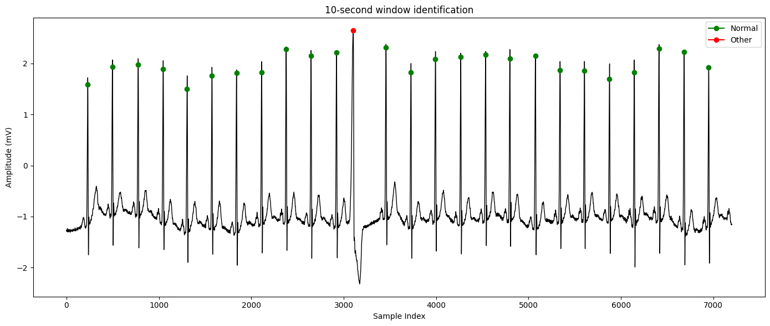
Methodologies
10-second:
Read annotator files
Determine window (duration)
Extract if heartbeats are normal
Fixed length window
Article | Methodology | Type | Accuracy
Attia et al. 2019 | 10-second segments | Identification | 79%
- | Defined number of beats per segment | - | -
Duan et al. 2022 | RR intervals (RRI) | Detection | 98.4%
Castro et al. 2020 | Peaks metrics | Detection | 97.4%
Alexandre Chapelle
000524758
Identification of patients with atrial fibrillation during normal sinus rhythm using different methodologies and machine learning techniques
Methodologies

Slide 21
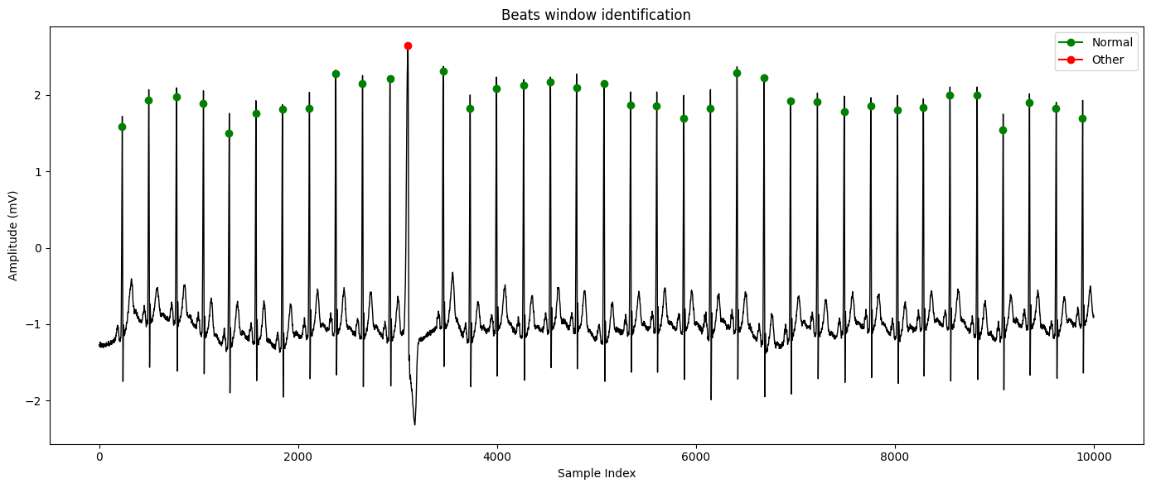
Methodologies
Beats:
Read annotator files
Determine window (number of heartbeats)
Extract if heartbeats are normal
Non-fixed length window
Article | Methodology | Type | Accuracy
Attia et al. 2019 | 10-second segments | Identification | 79%
- | Defined number of beats per segment | - | -
Duan et al. 2022 | RR intervals (RRI) | Detection | 98.4%
Castro et al. 2020 | Peaks metrics | Detection | 97.4%
Alexandre Chapelle
000524758
Identification of patients with atrial fibrillation during normal sinus rhythm using different methodologies and machine learning techniques
Methodologies

Slide 22
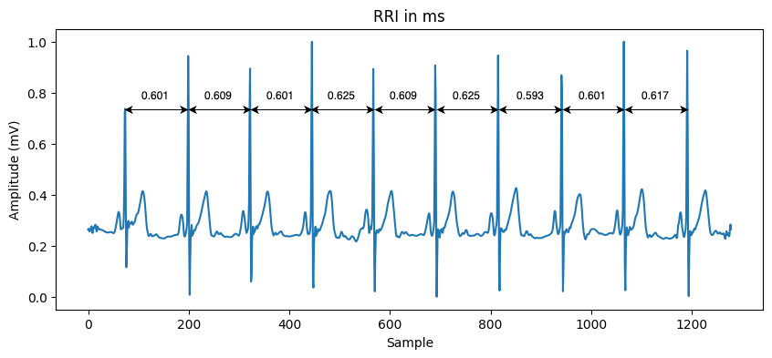
Methodologies
RRI:
Read annotator files
Determine window (number of heartbeats)
Extract if heartbeats are normal
Compute the RR intervals
Article | Methodology | Type | Accuracy
Attia et al. 2019 | 10-second segments | Identification | 79%
- | Defined number of beats per segment | - | -
Duan et al. 2022 | RR intervals (RRI) | Detection | 98.4%
Castro et al. 2020 | Peaks metrics | Detection | 97.4%
Alexandre Chapelle
000524758
Identification of patients with atrial fibrillation during normal sinus rhythm using different methodologies and machine learning techniques
Methodologies

Slide 23
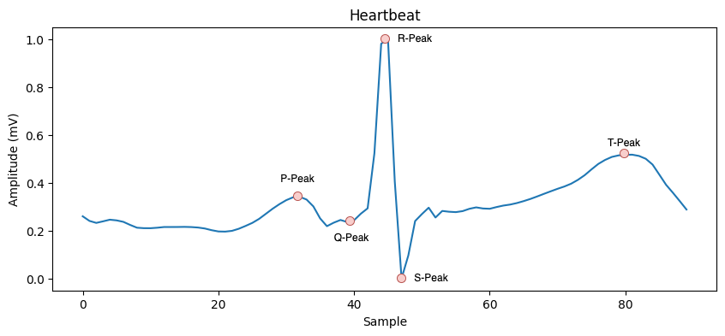
Methodologies
Peaks:
Read annotator files
Determine window (number of heartbeats)
Isolate the heartbeat
Extract the important metrics
P-peak
Q-peak, R-peak, S-peak
T-peak
Article | Methodology | Type | Accuracy
Attia et al. 2019 | 10-second segments | Identification | 79%
- | Defined number of beats per segment | - | -
Duan et al. 2022 | RR intervals (RRI) | Detection | 98.4%
Castro et al. 2020 | Peaks metrics | Detection | 97.4%
Alexandre Chapelle
000524758
Identification of patients with atrial fibrillation during normal sinus rhythm using different methodologies and machine learning techniques
Methodologies

Slide 24
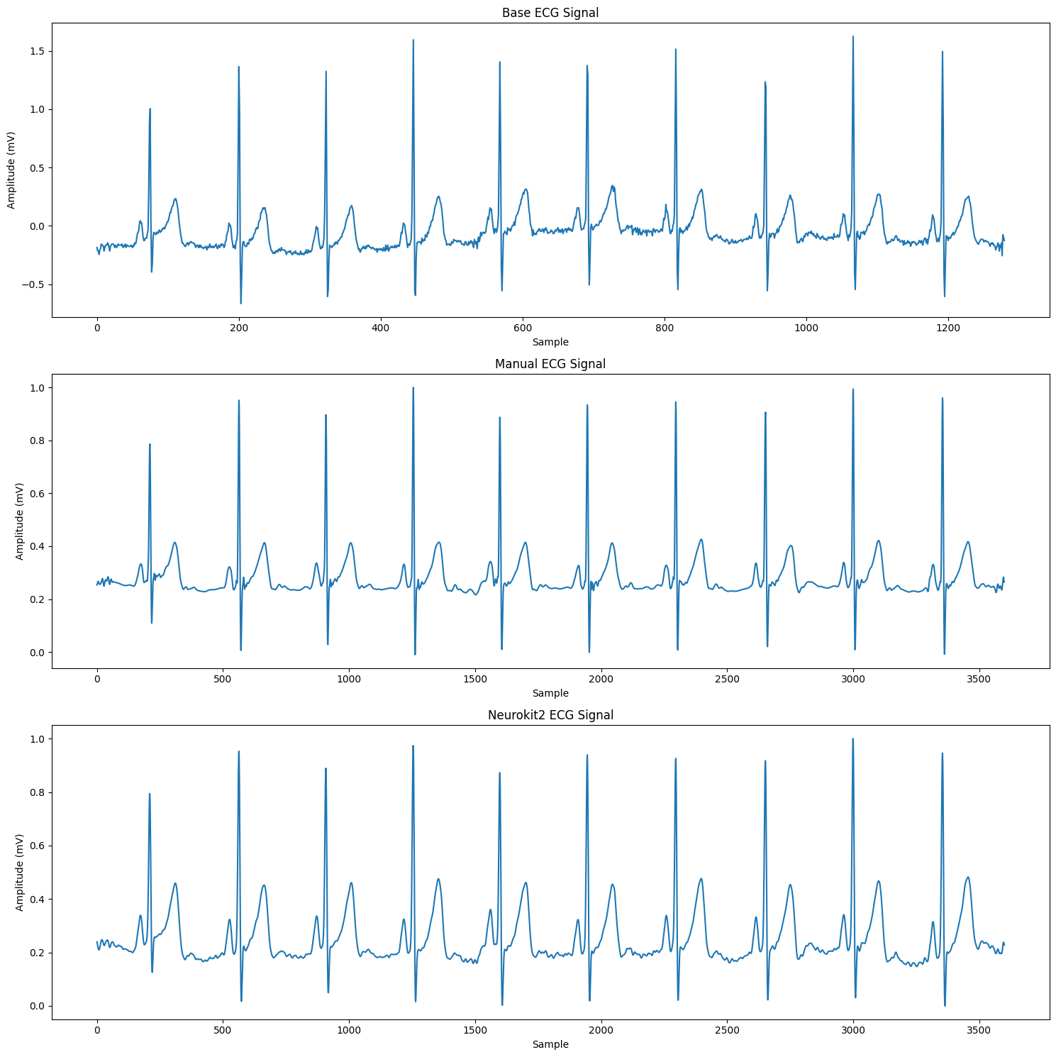
Methodologies
Pre-processing:
ECG inversion
ECG resampling (360 Hz)
ECG cleaning
Manual
Butterworth filter (smooth frequency)
Wavelet denoising (noise reduction)
Automatic (Neurokit2)
Raw
Excellent segments
ECG rescaling
Alexandre Chapelle
000524758
Identification of patients with atrial fibrillation during normal sinus rhythm using different methodologies and machine learning techniques
Methodologies

Slide 25
Methodologies
Models:
Random Forest (200 trees)
Alexandre Chapelle
000524758
Identification of patients with atrial fibrillation during normal sinus rhythm using different methodologies and machine learning techniques
Methodologies

Slide 26
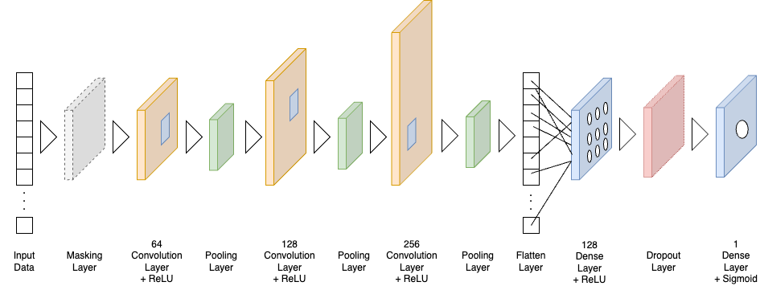
Methodologies
Models:
Random Forest (200 trees)
CNN
Alexandre Chapelle
000524758
Identification of patients with atrial fibrillation during normal sinus rhythm using different methodologies and machine learning techniques
Methodologies

Slide 27
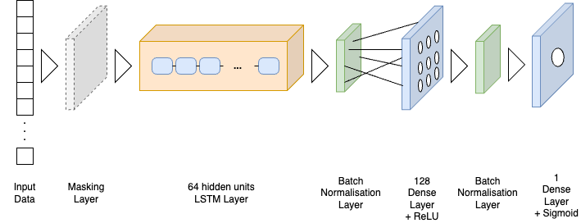
Methodologies
Models:
Random Forest (200 trees)
CNN
LSTM
Alexandre Chapelle
000524758
Identification of patients with atrial fibrillation during normal sinus rhythm using different methodologies and machine learning techniques
Methodologies

Slide 28
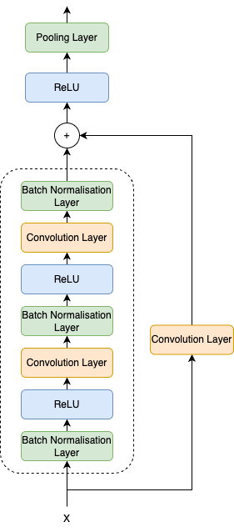
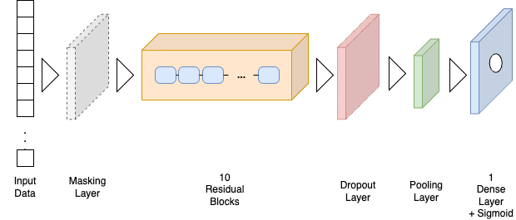
Methodologies
Models:
Random Forest (200 trees)
CNN
LSTM
ResNet
Alexandre Chapelle
000524758
Identification of patients with atrial fibrillation during normal sinus rhythm using different methodologies and machine learning techniques
Methodologies

Slide 29
Results

Slide 30
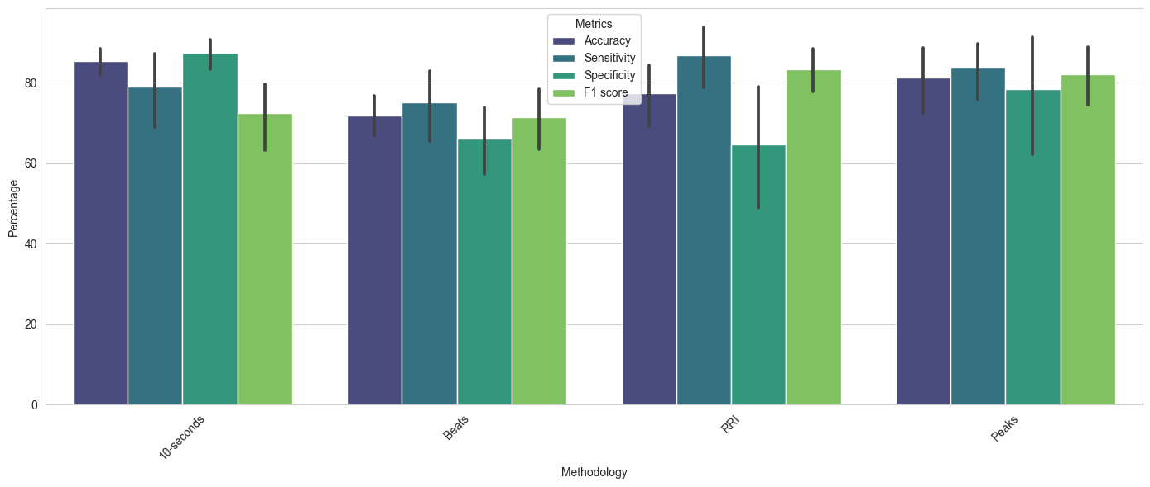
Results
Methodologies
 | Accuracy | Sensitivity | Specificity | F1 Score
10-second | 85.4 | 79.1 | 87.5 | 72.4
Beats | 71.9 | 75.0 | 66.1 | 71.5
RRI | 77.4 | 86.8 | 64.6 | 83.4
Peaks | 81.2 | 84.0 | 78.5 | 82.1
Alexandre Chapelle
000524758
Identification of patients with atrial fibrillation during normal sinus rhythm using different methodologies and machine learning techniques
Results

Slide 31
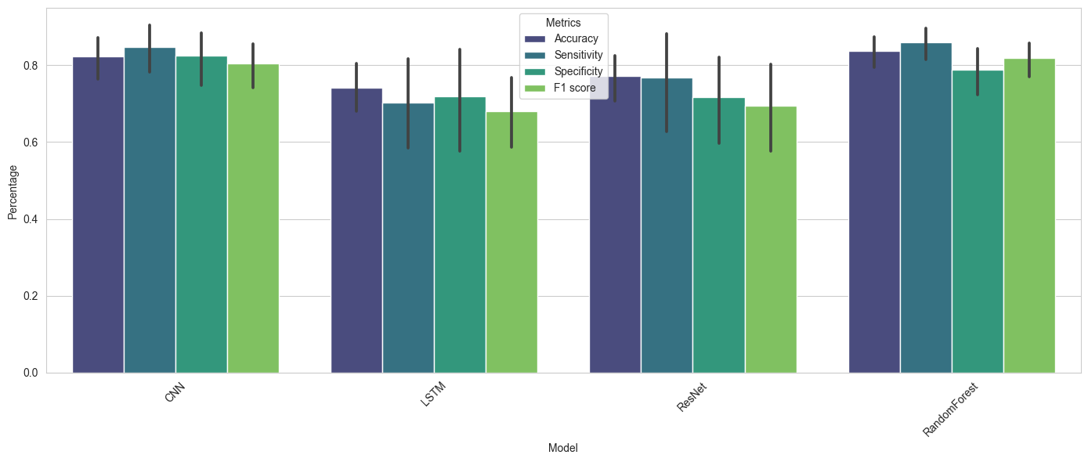
Results
Models
 | Accuracy | Sensitivity | Specificity | F1 Score
CNN | 82.3 | 84.8 | 82.4 | 80.4
LSTM | 74.1 | 70.4 | 71.8 | 68.0
ResNet | 77.2 | 76.8 | 71.8 | 69.4
Random Forest | 83.8 | 85.9 | 78.7 | 81.9
Alexandre Chapelle
000524758
Identification of patients with atrial fibrillation during normal sinus rhythm using different methodologies and machine learning techniques
Results

Slide 32
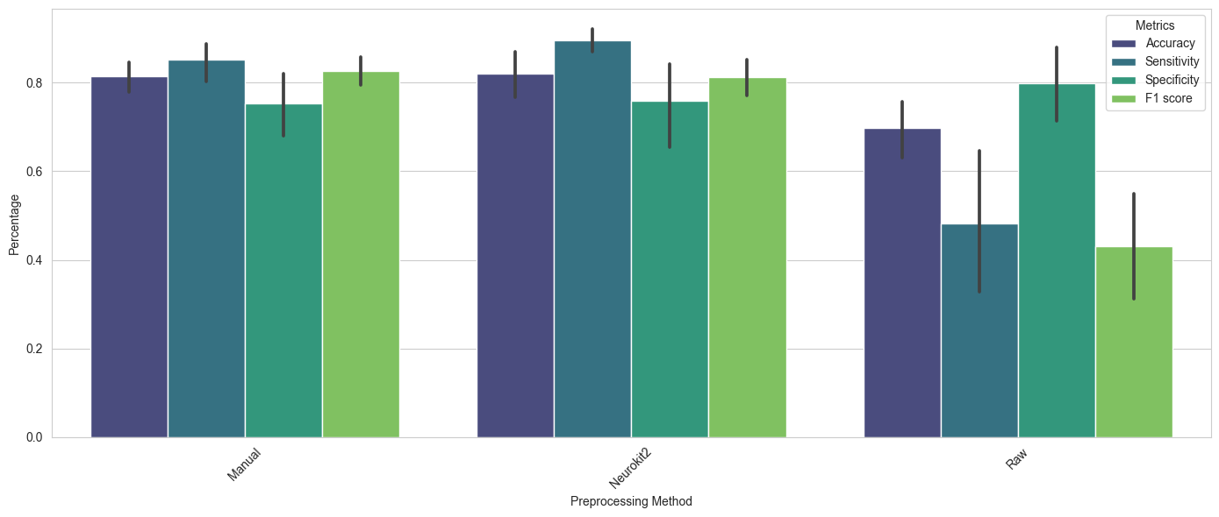
Results
Pre-processing methods
 | Accuracy | Sensitivity | Specificity | F1 Score
Manual | 83.4 | 85.2 | 75.2 | 84.7
Neurokit2 | 82.1 | 89.6 | 75.8 | 81.2
Raw | 69.8 | 48.3 | 80.0 | 43.1
Alexandre Chapelle
000524758
Identification of patients with atrial fibrillation during normal sinus rhythm using different methodologies and machine learning techniques
Results

Slide 33
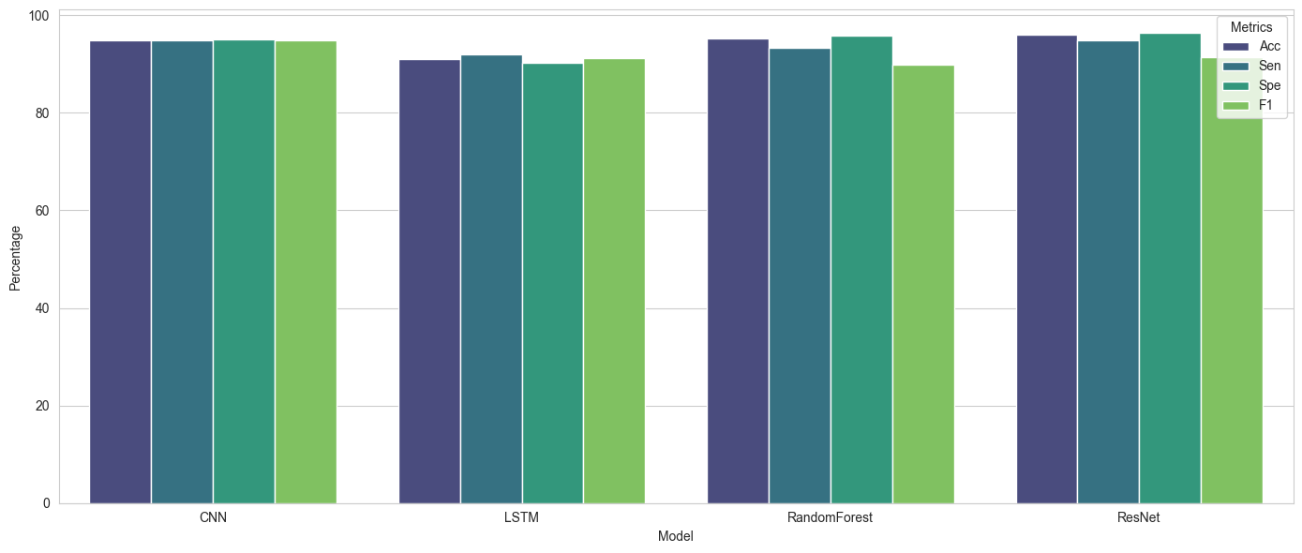
Results
Best performances
Methodology | Pre-processing | Duration | Model | Accuracy | Sensitivity | Specificity | F1 Score
10-second | Manual | 600 | ResNet | 96.0 | 94.8 | 96.4 | 91.4
10-second | Manual | 600 | Random Forest | 95.3 | 93.4 | 95.8 | 89.8
10-second | Neurokit2 | 600 | CNN | 94.9 | 94.9 | 95.0 | 94.9
10-second | Neurokit2 | 300 | LSTM | 91.1 | 92.0 | 90.3 | 91.2
Alexandre Chapelle
000524758
Identification of patients with atrial fibrillation during normal sinus rhythm using different methodologies and machine learning techniques
Results

Slide 34
Results
360 Hz
250 Hz
128 Hz
Different sampling frequencies
Methodology | Pre-processing | Duration | Model | Accuracy | Sensitivity | Specificity | F1 Score
10-second | Manual | 600 | ResNet | 96.0 82.7 73.8 | 94.8 85.8 76.4 | 96.4 84.6 67.7 | 91.4 83.4 59.1
10-second | Manual | 600 | Random Forest | 95.3 91.2 96.8 | 93.4 94.3 96.9 | 95.8 95.3 96.7 | 89.8 81.7 91.9
10-second | Neurokit2 | 600 | CNN | 94.9 90.4 95.0 | 94.9 94.4 79.9 | 95.0 93.9 94.1 | 94.9 73.0 88.2
10-second | Neurokit2 | 300 | LSTM | 91.1 61.9 95.7 | 92.0 53.0 96.6 | 90.3 54.1 95.4 | 91.2 52.4 90.3
Alexandre Chapelle
000524758
Identification of patients with atrial fibrillation during normal sinus rhythm using different methodologies and machine learning techniques
Results

Slide 35
Conclusion

Slide 36
Conclusion
Possible to identify atrial fibrillation during normal sinus rhythm
4 distinct methodologies
4 models and 3 pre-processing techniques
24 datasets
Highlight the potential of AI for the medical field
Limitations due:
To the data
To the uniform application of the models
Adaptation of the models from the reference articles
Opens potential avenues for future exploration
Uniform dataset
Finetune models or try new solutions
Alexandre Chapelle
000524758
Identification of patients with atrial fibrillation during normal sinus rhythm using different methodologies and machine learning techniques
Conclusion

